Slide 1

General Practice Smoking-Status Assessment and Referral Tool (GP-SmART)

Slide 2
Project Overview
Screening tool that predicts smoking status based on presence of biological-signals in human body.
To be used in a primary health care setting by GP/practice nurse.
Refers to tailored interventions based on severity of dependence.
Also includes interactive dashboard for practitioner to explore sample data.

Slide 3
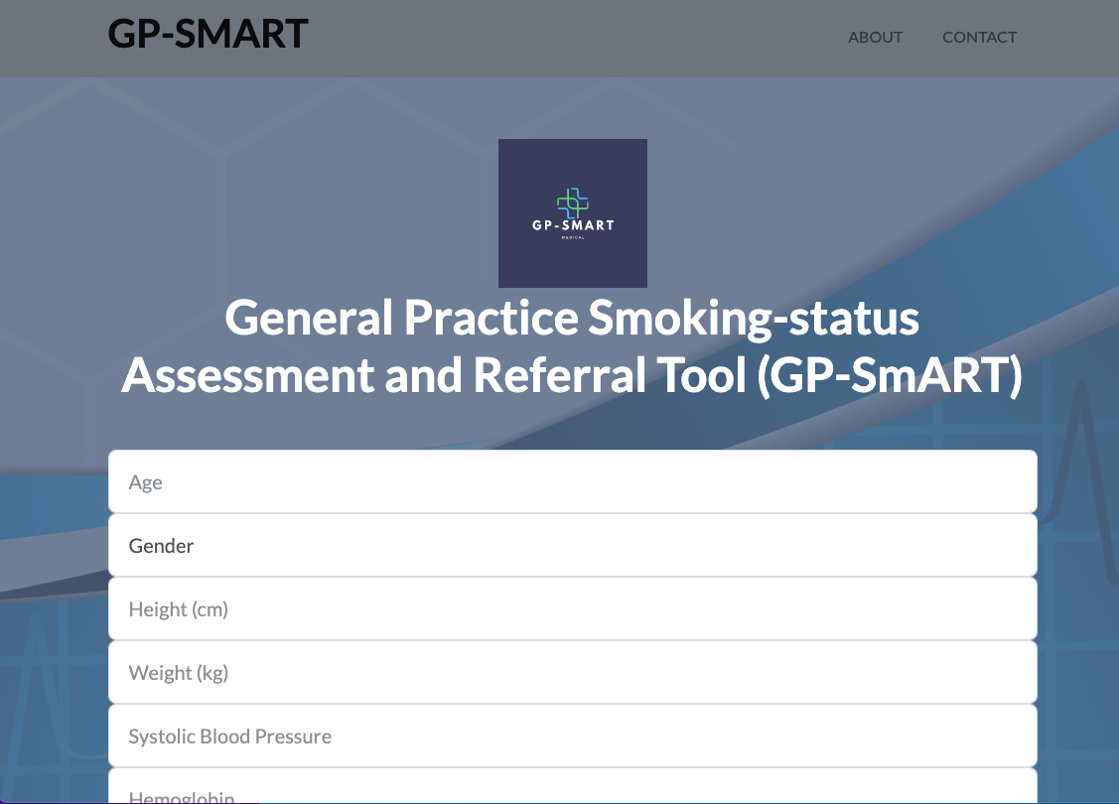

Slide 4
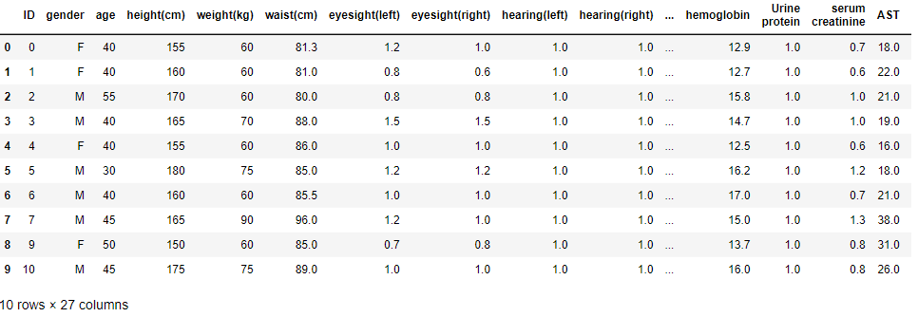
Data Source: https://www.kaggle.com/datasets/kukuroo3/body-signal-of-smoking

Slide 5
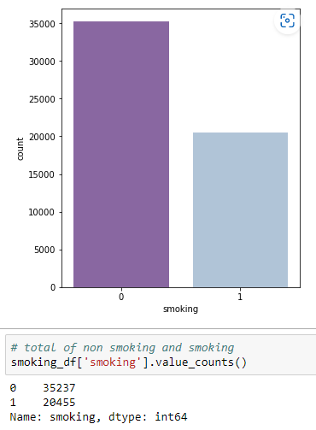
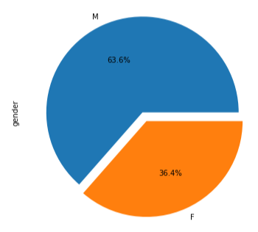
Exploratory Data Analysis (Part 1)
Notes:
Check on how data is distributed
Check on null values
Check on duplicates values
Change the categorical / non number value itu number so machine learning can understand it

Slide 6
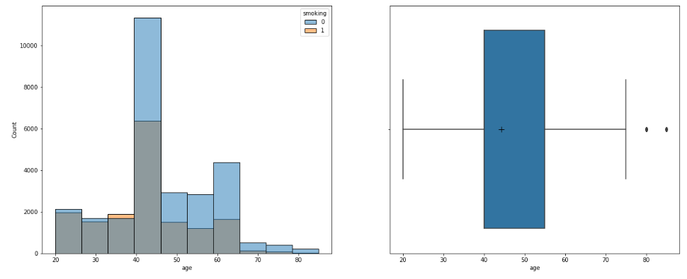
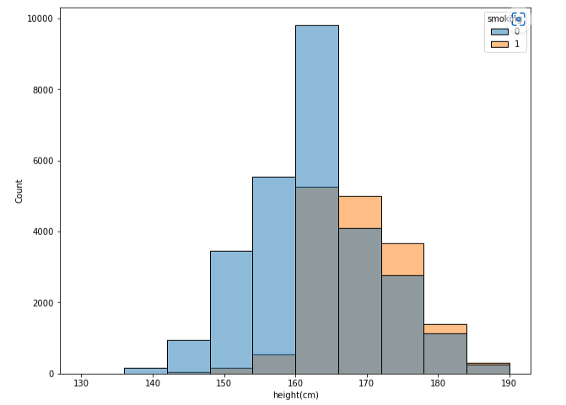
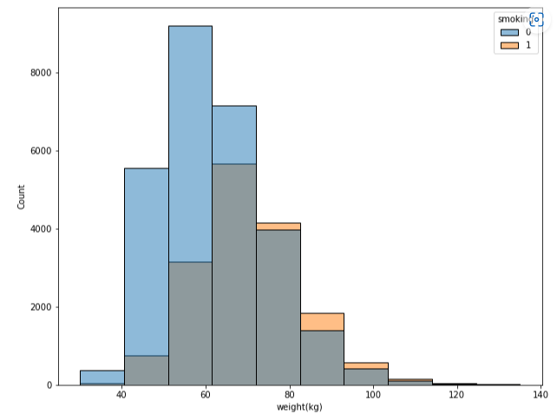
Exploratory Data Analysis (Part 2)

Slide 7
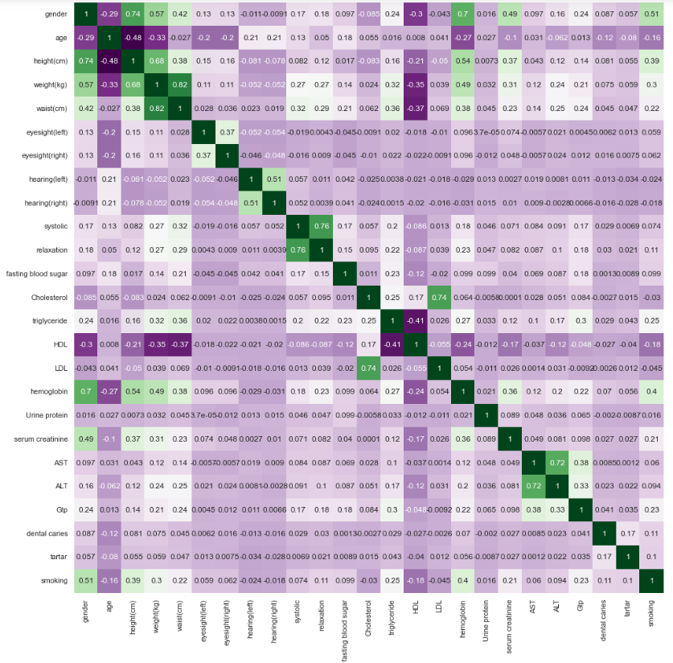
Exploratory Data Analysis (Part 3)
Notes:
Heat map of the correlation matrix of different features.
Hemoglobin has the maximum positive linear correlation with smoking, which is logical.
HDL has the highest negative linear correlation with smoking.
Surprisingly, age has a negative linear correlation with smoking.

Slide 8
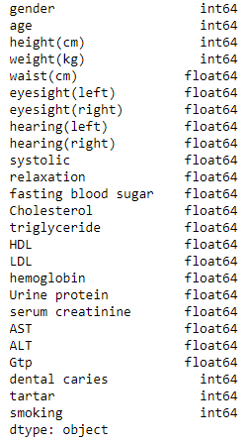
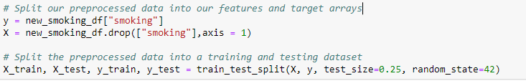
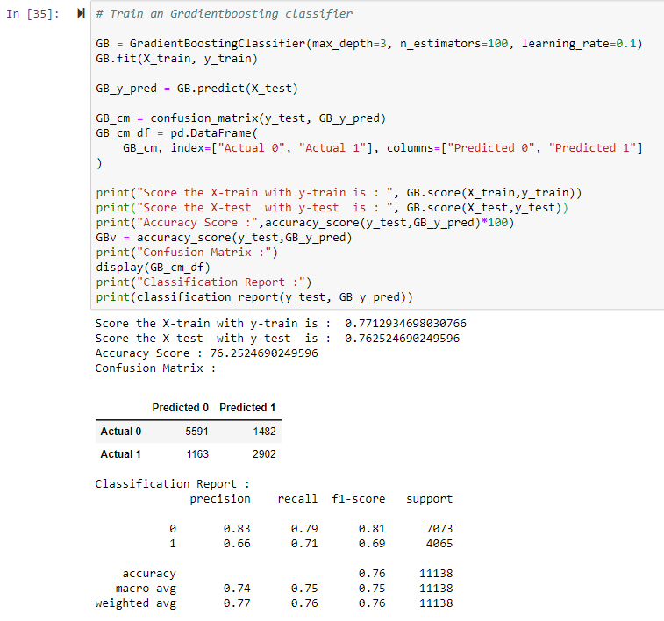
Pre-processing and model selection
Notes:
Split our preprocessed data into our features and target arrays
Split into training and test data set: Using train test split, we split the whole dataset into training and validation set before testing it on the test set.
In summary, the code performs feature selection using SelectKBest and the f_classif scoring function to select the top 10 features based on their F-values. It then prints the names of the selected features. This technique helps identify the most informative features for the classification task and can potentially improve the model's performance by reducing the dimensionality of the input data.

Slide 9
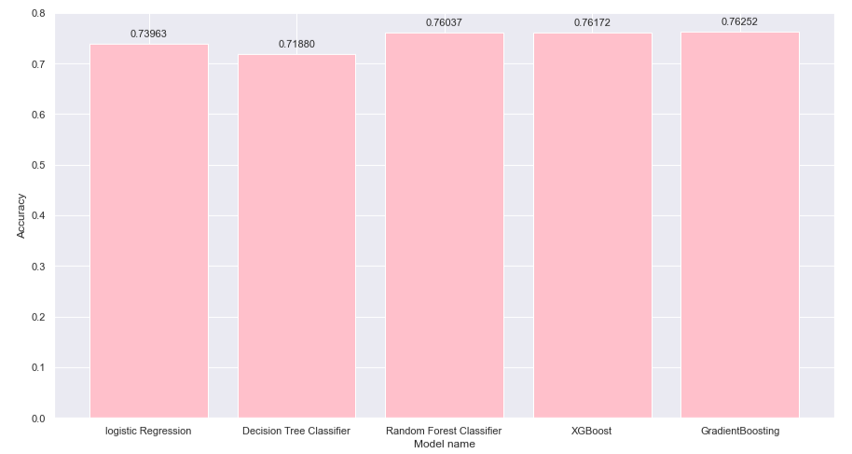
Model SES

Slide 10
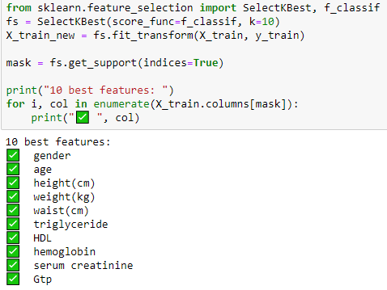
Attempt to Improve the Model
Applying Different Technique:
Eliminate outliers and Scaling the Data (Standard Scaler / Min Max )
Random OverSampler
ANOVA (Analysis of Variance)
Notes:
Scaling the Data: Scaling the data is primarily used to address the issue of features having different scales or units. It ensures that features are on a similar scale, which can be important for certain algorithms that are sensitive to the magnitude of the features. Scaling is typically applied to the input features of a dataset and does not directly address class imbalance or data distribution.
Random Oversampling: Random oversampling is a technique used to tackle class imbalance in a dataset, where one class has significantly fewer instances compared to the other class(es). It involves generating synthetic samples from the minority class or replicating existing samples to balance the class distribution. Random oversampling aims to provide more training data for the minority class, enabling the model to learn its patterns more effectively and improve performance on the minority class.

Slide 11
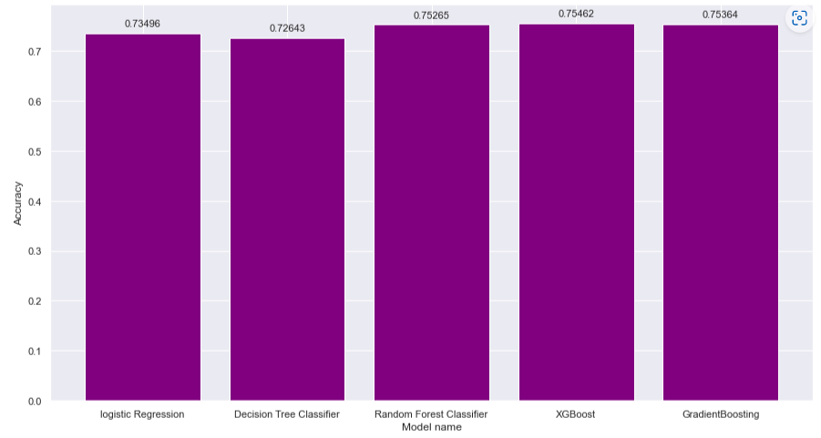
Results?
Notes:
Use 10 best features and Gradient Boosting model to build the app which have 75% accuracy score

Slide 12
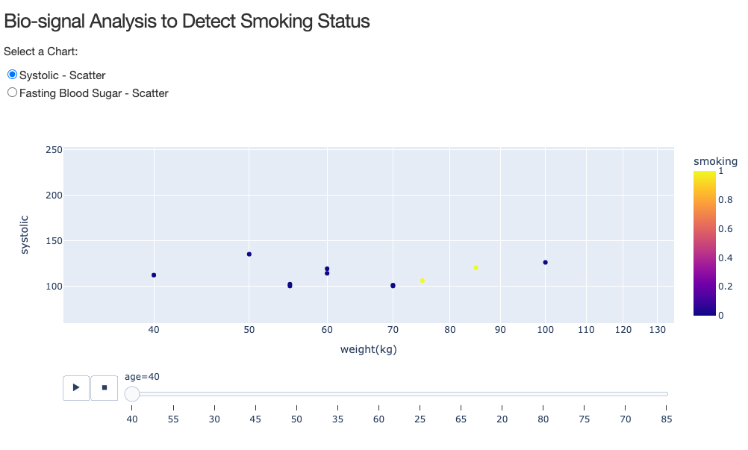
DashBoard
Notes:
Used Plotly Dash for the Dashboard. Dash is a free python library that can be customized without using HTML and JS.

Slide 13
 | Patient 1 | Patient 2 | Patient 3
Age | 45 | 40 | 25
Gender | M | M | F
Height | 170 | 170 | 170
Weight | 60 | 60 | 50
Systolic | 120 | 90 | 126
Hemoglobin | 15.6 | 16.9 | 15.6
Triglyceride | 159 | 81 | 48
HDL | 52 | 40 | 79
Serum | 0.9 | 1.2 | 0.9
GTP | 79 | 22 | 9
Notes:
The inputs used in the demonstration

Slide 14
Live Demo App and Thanks All :)

